Slide 1
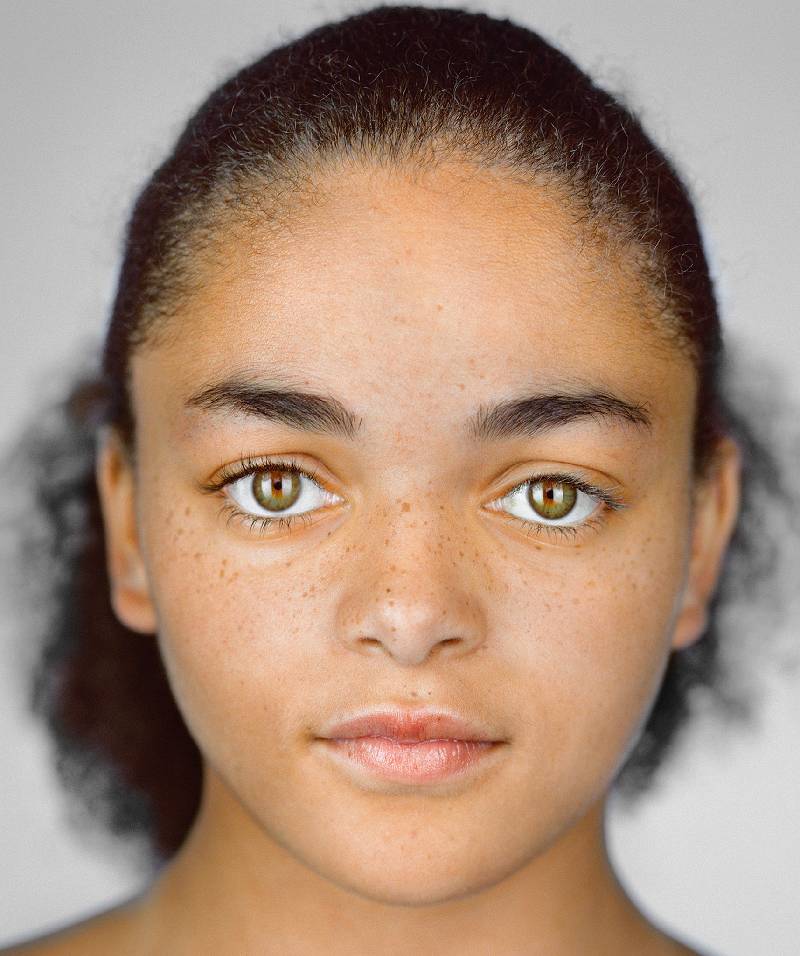



Lindsey Balls, 29, Homemaker Married citizen of Charlotte Spends free time in the Uptown area
BIO
Lindsey is a very outgoing socialite. She often regrets her purchases and wishes to redirect her spending into things that give her more enjoyment.
Goals
Personality
Wants to use money for her in house office.
To spend less on social engagements
Socially outgoing
Appreciates service industry
Loves “artsy” events
Frustrations
Tech Ability
Spending too much on food and drinks
Not having the things she wants with the money she makes
Applications:
IT & Internet
Games:
Social Media:

Slide 2
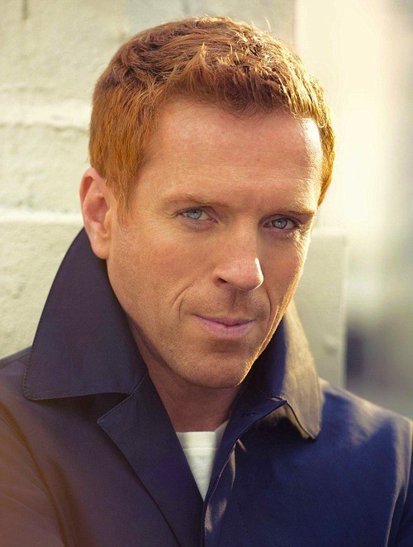
Albert Hanson, 41, Investment Banker Commutes to Charlotte for work Spends his time with his 4 children
BIO
Albert is a middle aged investment banker at Wells Fargo. He is a single father of 4 children. He commutes to Charlotte from nearby Huntersville. He plays video games and loves going on walks with his dogs. He wants to build a motorcycle but can’t seem to find the extra funds and wishes to work on his spontaneous spending
Goals
Personality
Save extra money for motorcycle
Work on spontaneous spending
Lives in a town close to Charlotte
Commutes 45+ minutes work every day
Dad of 4
Frustrations
Tech Ability
Going paycheck to paycheck
Eats out too much
Applications:
IT & Internet
Games:
Social Media:

